Slide 1
Creation of an OSIA
Abdallah Daimi Syed, Jordan Kauffman

Slide 2
Project Plan Overview
Project Duration:
April 18 – April 25
Team Members:
Jordan Kauffman
Abdallah Daimi Syed
Primary Communication Channel:
Discord (for daily communication and coordination)
Collaboration Tools:
Monday.com (task management, risk tracking)
GitHub (code repository, version control)
No formal budget (all open-source or free-tier tools used)

Slide 3
Goals Overview
Project Goals:
Develop a functional OSINT application integrating research and APIs.
Conduct research on relevant data sources and prepare proper documentation.
Present the tool effectively to demonstrate understanding and application.
Submit final deliverables by April 25.

Slide 4
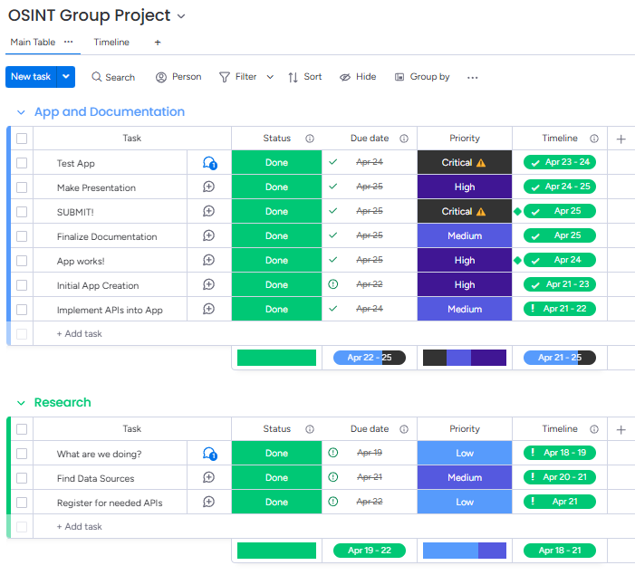
Project Management
(via Monday.com)
Diamonds indicate Milestones

Slide 5
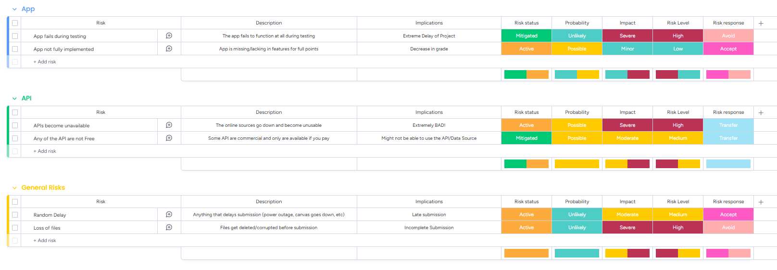
Risk Management
(via Monday.com as well)
Risks were broken down by section (I.E. possibilities that could occur per section of the project)

Slide 6
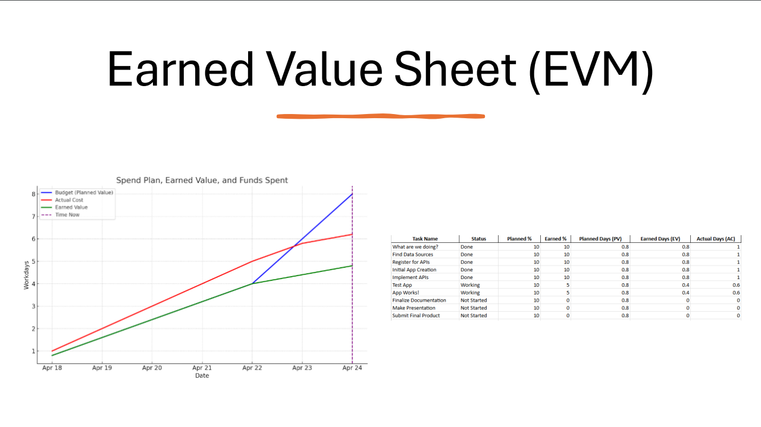

Slide 7
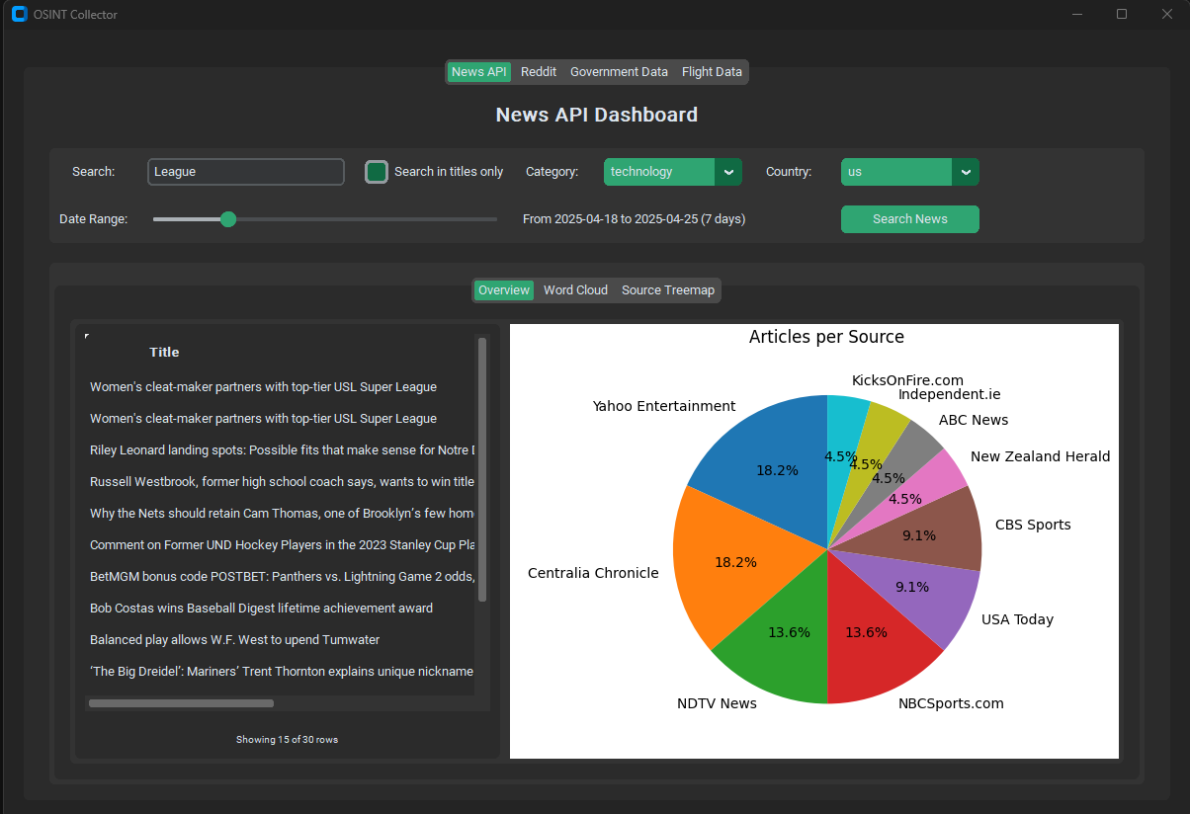
Usage Example (NewsAPI)

Slide 8
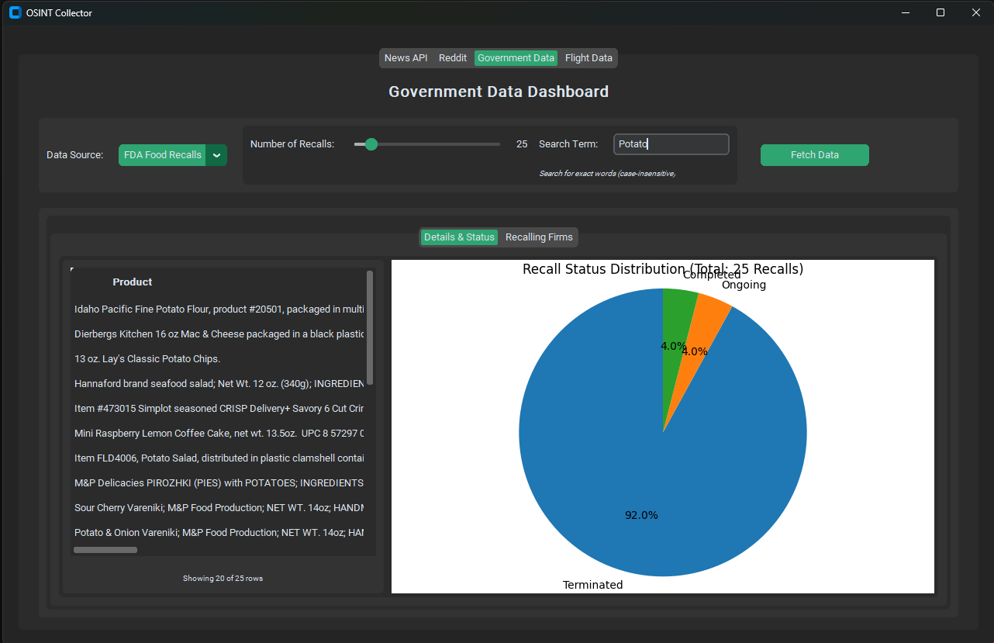
Usage Example (FDA)

Slide 9
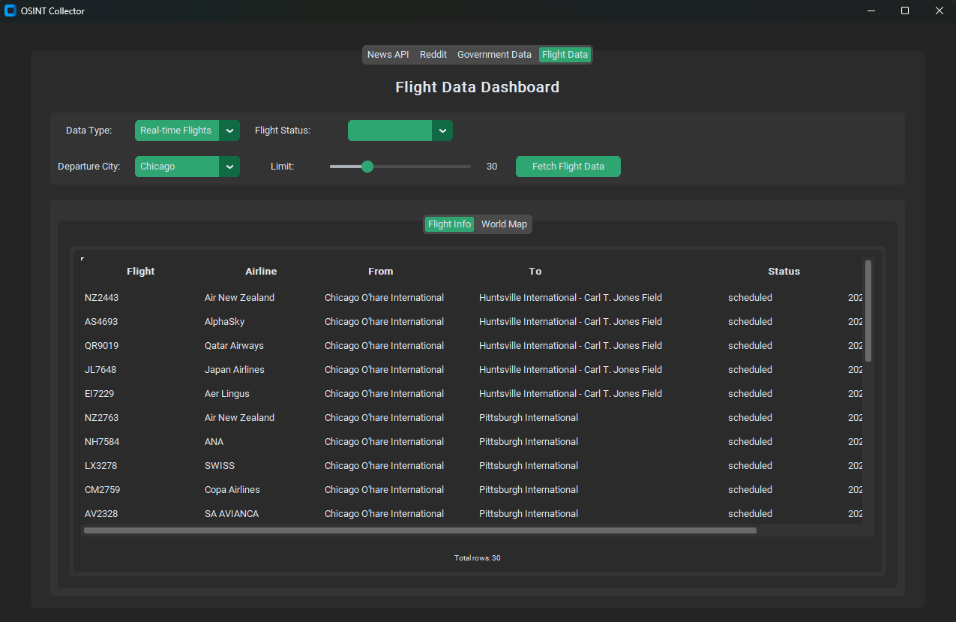
Usage Example (Flight Data)

Slide 10
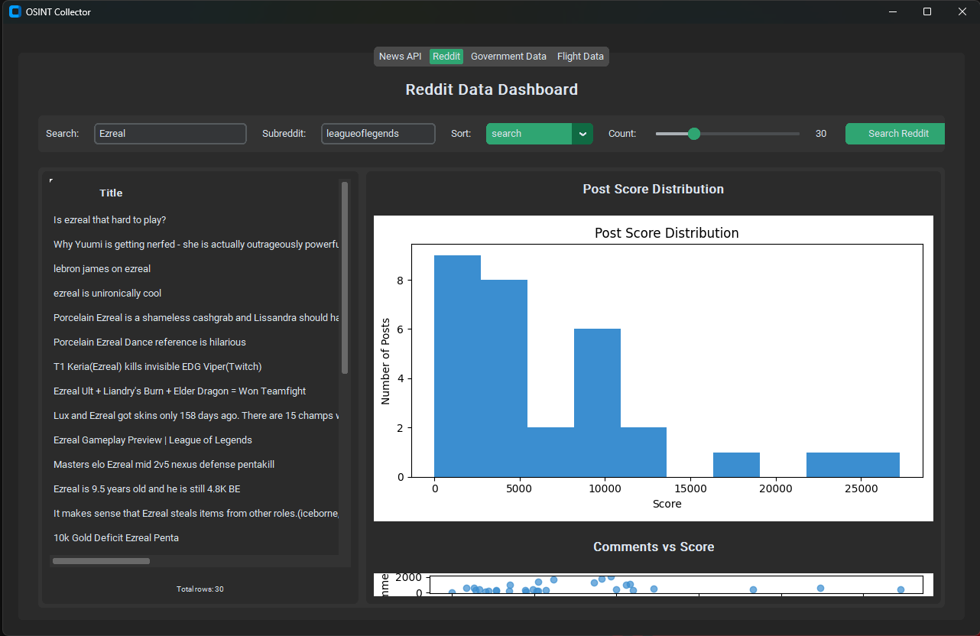
Usage Example (RedditAPI)

Slide 11
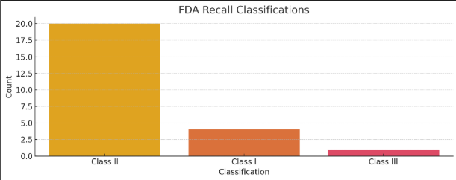
Data Analysis (FDA Recalls on Potatoes)
Across 25 recalls, it was found that there were:
12 main recalling firms
Most commonly were Class II classifications (Moderate Risks)
Temperature was found to be the most common reason for recall

Slide 12
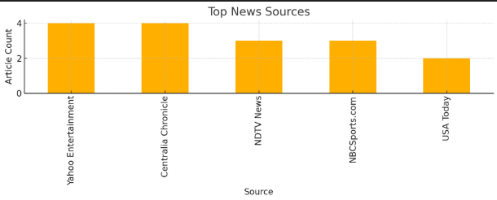
Data Analysis (NewsAPI)
Search term used - "League"
Visual provides breakdown of how each major source reported on the chosen term

Slide 13
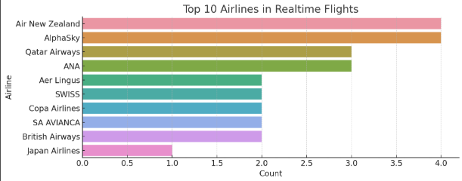
Data Analysis (Flights)
Tracked 30 flights from Chicago O'Hare Airport
15 Unique Airlines were identified
Visual demonstrates the most common Airlines for these flights

Slide 14
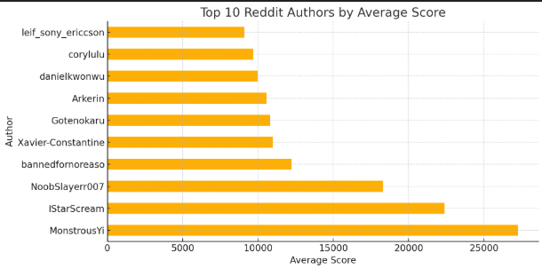
Data Analysis (RedditAPI)
Searched term – Ezreal
Chosen subreddit – r/leagueoflegends
See visual for the breakdown of scores per identified user
Highest scoring post revealed to be a post in reference to the source of an in-game emote

Slide 15
Link to Github Repository
https://github.com/daimi16/OSINT

